Slide 1
Software product management Core concepts
Nandagopal Govindan

Slide 2
Contents
Principles of product management
Characteristics of a holistic product
Product-Market fit
Problem space vs Solution space
User vs buyer
Continuous discovery and delivery
Product eco-system
Critical success factors

Slide 3
Principles of product management
Establish compelling value. Examples:
MakeMyTrip – a one stop shop for travel,
Postman – Make API testing easy
Many of our ideas won't work out, and the ones that do will require several iterations. Examples:
Slack - Initially they developed a multi-player online game which did not succeed, but the inbuilt messaging feature became successful.
MakeMyTrip initially targeted Indian travellers, but was not successful. Later targeted NRIs
We must validate our ideas on real users and customers. Examples:
Bounce – Validated the ‘Rent-a-bike’ idea by investing in a few scooters
AirBnB – Rented their apartment to conference attendees
Validate ideas fast and with minimal cost – the more we delay, we may be expending more effort & cost on an idea that does not have a market.
Have you experienced any of these principles?

Slide 4
Different aspects of a product
Functionality: Example booking tickets is one function of MakeMyTrip
Technology: Example: Microservices architecture used by Amazon, Encryption used by WhatsApp, AI/ML used by Logically
User experience: (UX): Example Tally’s ease of use for non-finance people
How do we monetize?: Example through transaction fee of Payment gateways or subscription fee of SalesForce
How we attract & acquire customers? Example: Freemium of Zoom, cash back of Paytm, Search Engine Optimization, Ads
Offline experience: Example: Merchandise fulfilment experience and merchandise return experience of Amazon & FlipKart, support experience by call center personnel, self help material on website

Slide 5
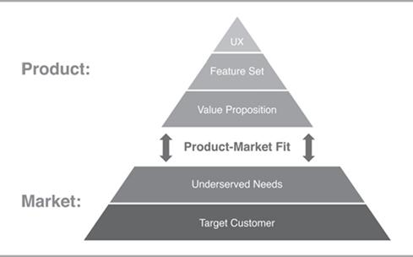
Product-Market fit
It is about how well the product meets the needs of the customer (market)
Good Product/market fit results in happier customers, lower churn rates, shortened sales cycles, and rapid organic growth. (Inspired)
You can always feel when product/market fit isn't happening. The customers aren't quite getting value out of the product, word of mouth isn't spreading, usage isn't growing that fast, press reviews are kind of "blah", the sales cycle takes too long, and lots of deals never close.

Slide 6
Product-Market fit
Marc Andreessen coined the term product-market fit in a well-known blog post titled “The only thing that matters.” (https://pmarchive.com/guide_to_startups_part4.html)
In a great market -- a market with lots of real potential customers -- the market pulls product out of the startup. Example
eCommerce, EdTech, FinTech
Conversely, in a terrible market, you can have the best product in the world and an absolutely killer team, and it doesn't matter -- you're going to fail. Example:
Video conferencing (2007), Iridium satellite phone
Do you know of any great product that failed?
Great products sometimes create huge new markets – examples:
Virtual machine by VMWare, smart phone by Apple
Any other?
The only thing that matters is getting to product/market fit.

Slide 7
Problem space vs Solution space
Problem space consists of customer needs and pain points.
However problems are not always easy to know:
Customers express their needs in terms of existing solutions.
For example they say “I need a cab in 5 minutes”, because they think cab is the only solution
The real need is to go from A to B.
There can be many solutions for this:
Hire a cab,
Use self-driving scooter or car,
Hail a bike taxi.
Any other?
Therefore before finding a solution, we need to understand the real need / problem
Understand what customer needs and why
Observe what he does, why he does it, etc. (Persona)
“If I had only one hour to solve a problem, I would spend up to two-thirds of that hour in attempting to define what the problem is.”

Slide 8
Problem space vs Solution space…
What differentiates one product from another is the quality of solution. Examples:
Space pen: Need is to write in space. US designed an ink pen that works in zero gravity. Russians used a simple pencil
Progressive auto insurance: Customer wanted quick settlement of car insurance claim. A process that took 6-7 days was cut down to 1 day through innovative solution
MoveWorks: Users need quick IT support to install say a Project management software. Solutions can be: Raise a ticket, Call IT support, Use MoveWorks bot which will check your eligibility and download the sw & install it instantly
Application maintenance service: Is faster problem resolution the need or zero problem the need
Any other example?

Slide 9

Problem space vs Solution space: Case study
Rivigo case
What did the founders do to discover the problem?
What was the real problem?
How did they solve the problem?

Slide 10
User vs Buyer
In large enterprises the decision makers are not the end users
Decision makers are usually VP and SVP. They want to solve a business problem / pain point.
Their concerns are functionality that brings business value (increase customer satisfaction, customer growth, reduce customer churn), productivity, security, reliability / stability / quality of solution
The end users typically do not have the power to approve the product. But ultimately they are the ones who are going to use the product. Hence it needs to be user friendly, efficient in performing their functions.
Example
Lotus Notes: It was a very secure team database and Email system. But not very user-friendly.
Cisco WebEx – very reliable but not very user friendly. But corporates prefer it.
Do you know of any other examples?
But this is changing with SaaS product. Management is becoming more aware of UI / UX

Slide 11
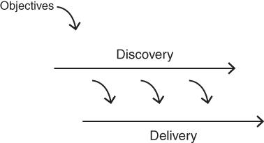
Continuous discovery and delivery
Discovery and delivery are our two main activities on a cross‐functional product team, and they are both typically ongoing and in parallel.
We are always working in parallel - to both discover the necessary product to be built—which is primarily what the product manager and designer work on every day—while the engineers work to deliver production‐quality product.
The engineers are also helping daily in discovery (and many of the best innovations come from that participation, so this is not a minor point), and the product manager and designer are also helping daily on delivery (mainly to clarify intended behavior). But this is what's going on at a high level.
Example Postman, Slack
Does this happen in your product company?

Slide 12
Product eco-system
Product should address the total customer experience (the whole offer)
Kaagaz & MS Office Lens (document scanner app on mobile) does not only scan but allows us to share the image via email, WhatsApp etc. Because the customer is not just interested in scanning and storing, he wants to share with others
Xerox started with photo copying facility but soon realized people need to staple the pages, need cover page in different colour, etc. So they enhanced the machine to address the total customer experience
Clarify: customer support software that involves tracking customer interaction, product details, knowledge base, workflows
No Broker.com: Find house, pay advance, get painter, get packer & mover
Have you come across other products that address total customer experience?

Slide 13
Product eco-system
Creating Partnerships & alliances
Xerox tied up with paper manufacturers to ensure steady supply of paper
SAP partners: DataXtream for POS solutions, DocuSign for eSignature integration with SAP
Netflix tied up with telecom service providers such as Verizon, Airtel to host their content at ISP gateways, so as to ensure fast response time to customers
MakeMyTrip built alliances with Airlines, hotels, etc.
Any other examples you have come across?

Slide 14
Critical success factors
Differentiation
Intuit – UI and features
Apple – UX
Citibank– Reliability & infrastructure
.Net – Ease of use
Toyota – Quality
ISRO – low cost satellite launches for world-wide customers
Entry barrier
Google Earth – Entry barrier due to technology
Da Vinci Robotic surgery – Technology
Microsoft HoloLens – Mixed reality technology for doctors, etc

Slide 15
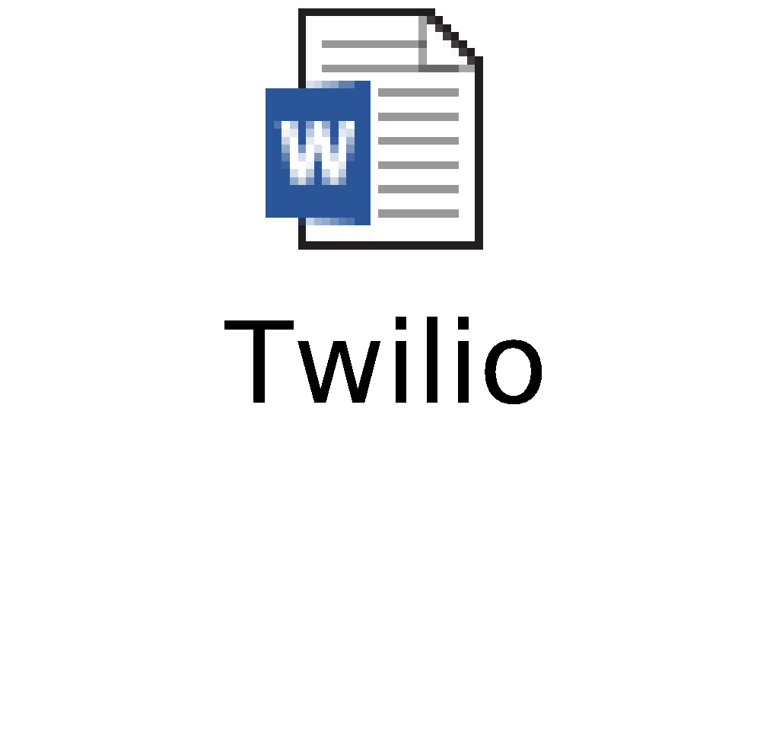
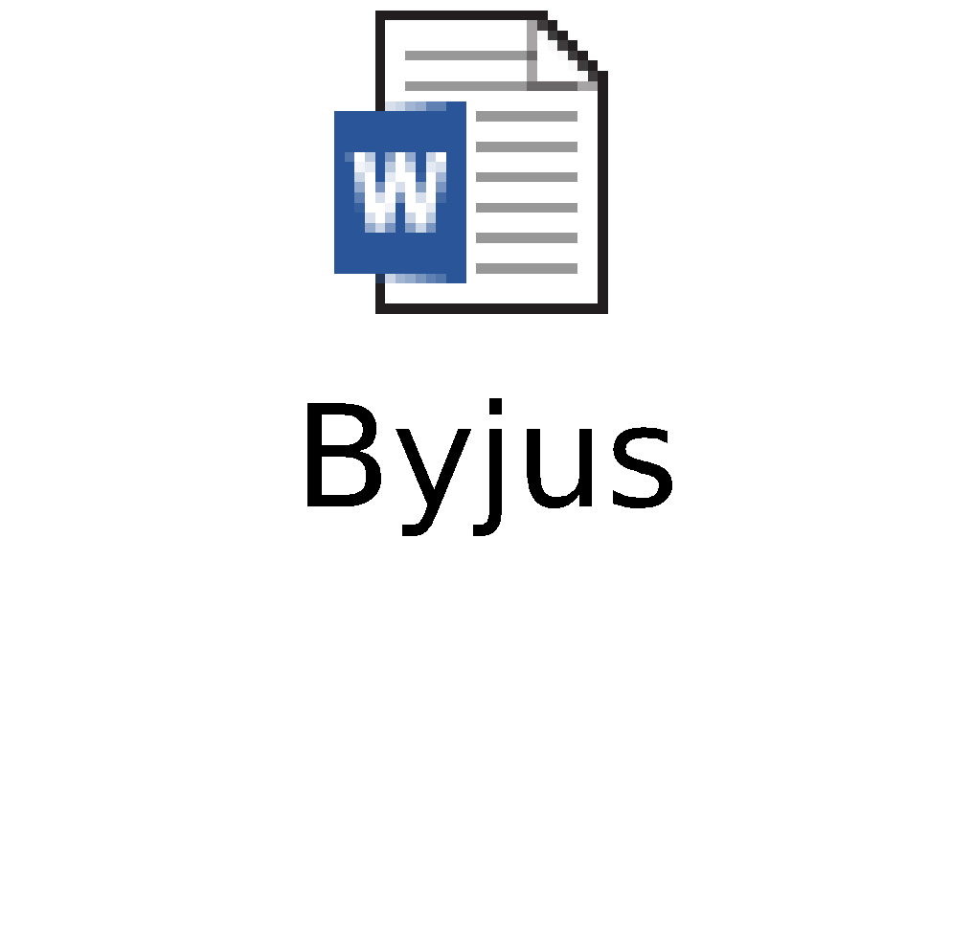
Case study
Twilio & Byju’s
What concepts are illustrated by these cases?

Slide 16
Case study…
User vs Buyer, Continuous discovery, Critical success factors, Customer acquisition
Twilio
User vs Buyer: Developer vs Org,
Continuous discovery & delivery: SMS, email, Call center,
Critical success factors: easy to use, even finance person can code this
Byju’s
User vs Buyer: Child vs parent
Customer acquisition - freemium model
Critical success factor:
Focus on learning to think rather than spoon feeding
Making it interesting and making children addictive

Slide 17
Appendix

